Slide 1

Music player App
By Sonawane poonam

Slide 2
Introduction :
Music player in this project is application based on core java. Music is one of the best ways to relieve pressure in stressful modern society life.
The music player app that allows user to quite, play next song, play previous song, replay the current song, list of all available songs, print all available options, delete current song on their home computer.

Slide 3
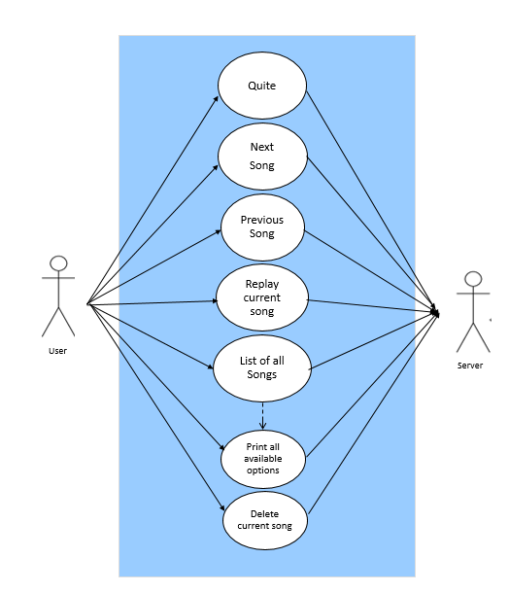
Use case Diagram :

Slide 4
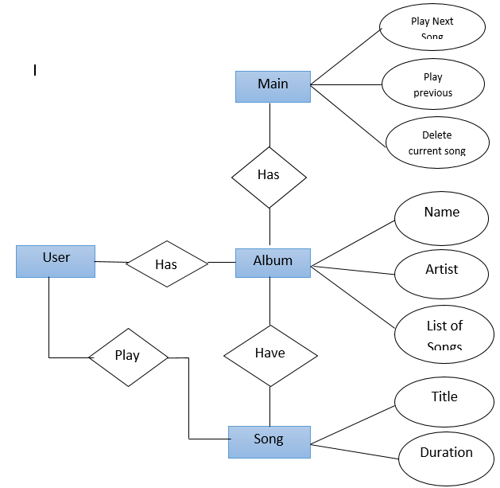
ER –Diagram:

Slide 5
Modules :
Album :
In album add songs to play list using the addSong() methods with title & duration, & track song. if add song return true print successfully added to list else return false print already exist in the list
Songs :
In song used iterator move to nextLine(), hasnext() check the next song is exist or not, hasPrevious() check the previous song is exist or not, printList() print the list of songs.
  Above all are the modules for the music player app. Through all these modules, We can perform different operations in music player app

Slide 6
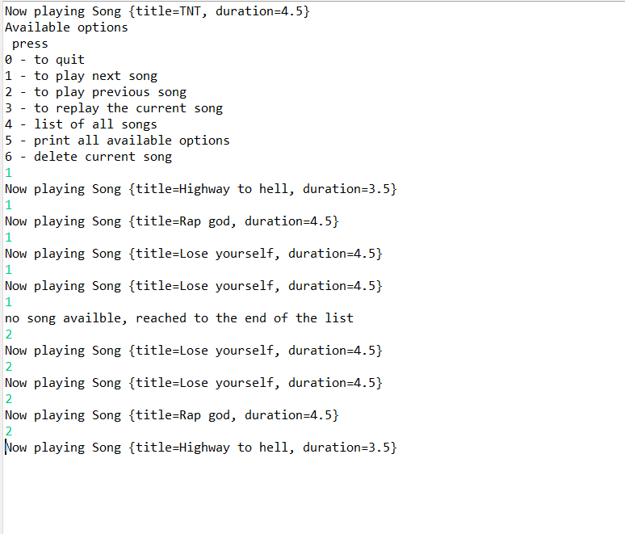
OUTPUT :

Slide 7
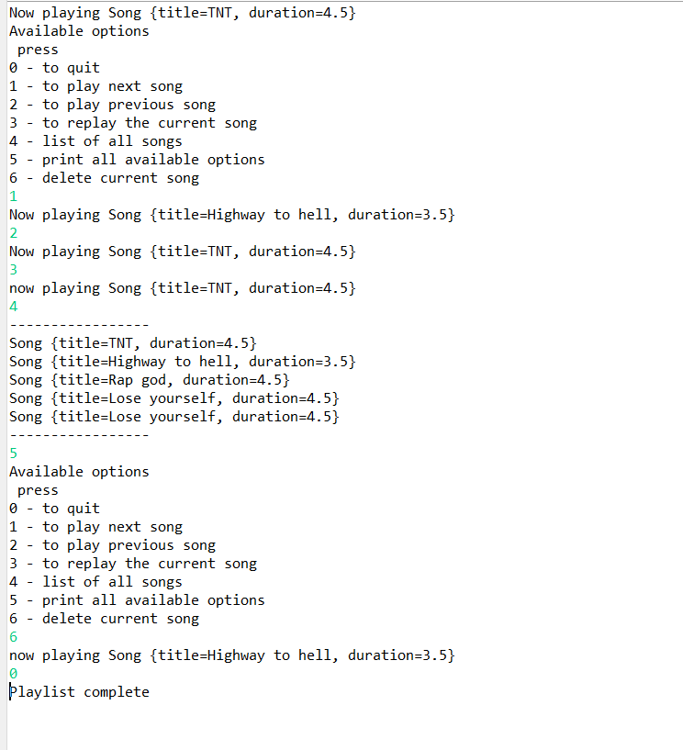
OUTPUT :

Slide 8
Requirements :
Hardware / Software Requirements:
Memory - 512
Free Disk Space – 300 MB
Processor Speed – 800 Mhz
Java Version – 8.0.16

Slide 9
Conclusion :
Through the development of music player app on core java, we understand the overall process of the program. This is combination of core java concepts. The music player app mainly composed of playing current song, next song, previous song, list of songs, delete songs.

Slide 10
References :
https://www.youtube.com
https://www.google.co.in

Slide 11


